Slide 1
Optimizing Hospitality
Data-Driven Insights into India's Hotel Economy
Project Overview & Analysis

Slide 2
Project Objectives
Analyze Customer Sentiment: Identifying regional values (service vs. cleanliness).
Find the Pricing 'Sweet Spot': Correlating nightly rates with guest satisfaction.
Regional Patterns: Focusing on Tier 1 economic hubs to identify growth trends.

Slide 3
Data Acquisition & Preparation
Python & Selenium: Custom scraper built to handle 'lazy loading' and AJAX content.
Data Cleaning: Pandas used for snake_case standardization and duplicate removal.
Scale: Data scraped for 8 major cities including Mumbai, Bengaluru, and Delhi.

Slide 4
Dataset Scale & Dimensions
• Total Records: 6,555 cleaned hotel entries.
• Total Market Reviews: 11 Million+ records analyzed.

Slide 5
Regional Market Share
• Dominance: Top 3 cities (Bengaluru, Delhi, Mumbai) control >50% of inventory.
• Emerging Hubs: Chennai, Hyderabad, and Kolkata represent strong secondary tiers.

Slide 6
Nightly Rate Statistics
Minimum: 544 INR | Maximum: 70,622 INR.
Average Market Price: 3,841 INR.
Median Price: 2,379 INR (indicates a heavily budget-skewed market).

Slide 7
Average Price per City

Slide 8
Guest Rating Trends
Leaders: Bengaluru (8.1) and Pune (8.0) maintain the highest standards.
Service Gaps: Mumbai (7.6) and Chennai (7.7) show the lowest satisfaction scores.

Slide 9
Value Analysis (Price vs. Rating)
Best Value: Bunk Hostel Delhi (8.7 rating at 544 INR).
Worst Value: Liberty Ahmedabad (5.9 rating at 17,636 INR).
Service Issues: High-visibility hotels (>1,000 reviews) failing to scale quality.

Slide 10
The Digital Engagement Gap
• Finding: 1,945 hotels (nearly 30% of dataset) have no rating.
• Impact: Unrated hotels average 2,577 INR vs 4,375 INR for rated hotels.
30% MARKET GAP:
Potential for Digital Growth

Slide 11
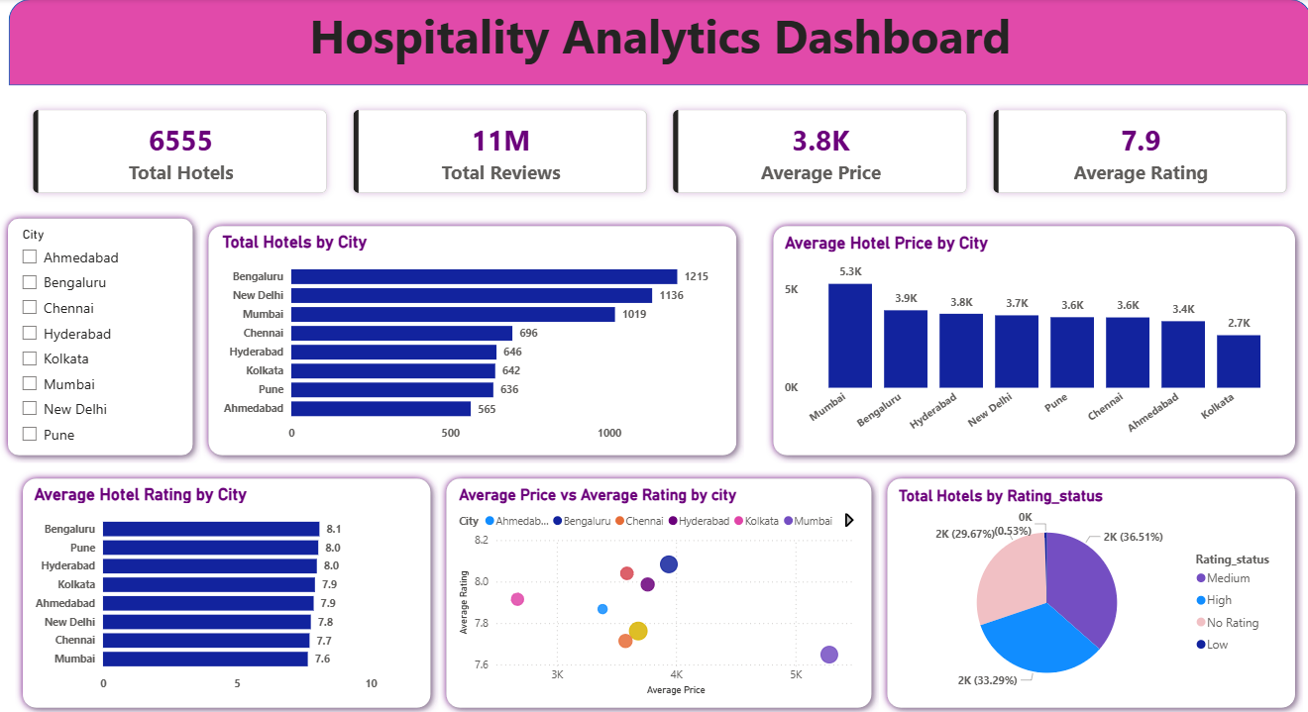
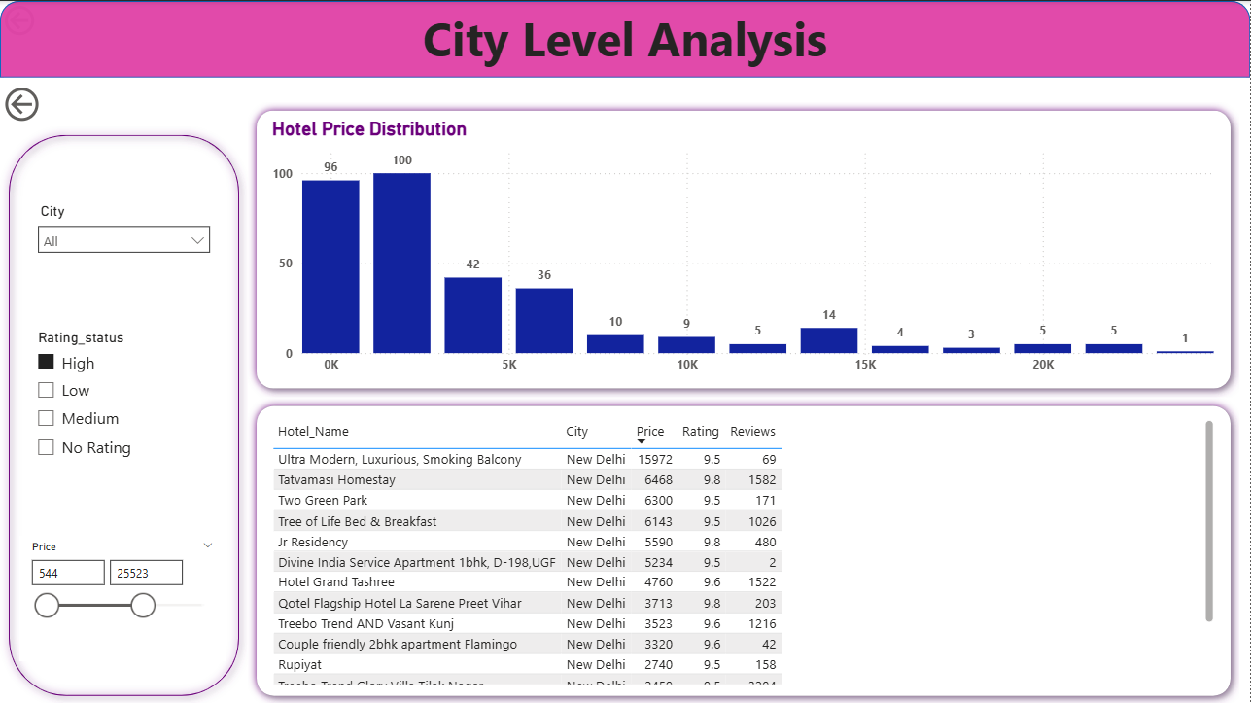
Power BI: National KPI Dashboard
• Page 1: Executive summary of 6,555 hotels and 11M reviews.
• Page 2: Tier 1 drill-down for Mumbai, Bengaluru, and Delhi.
• Dynamic Filtering: Real-time price vs. rating correlation analysis.

Slide 12
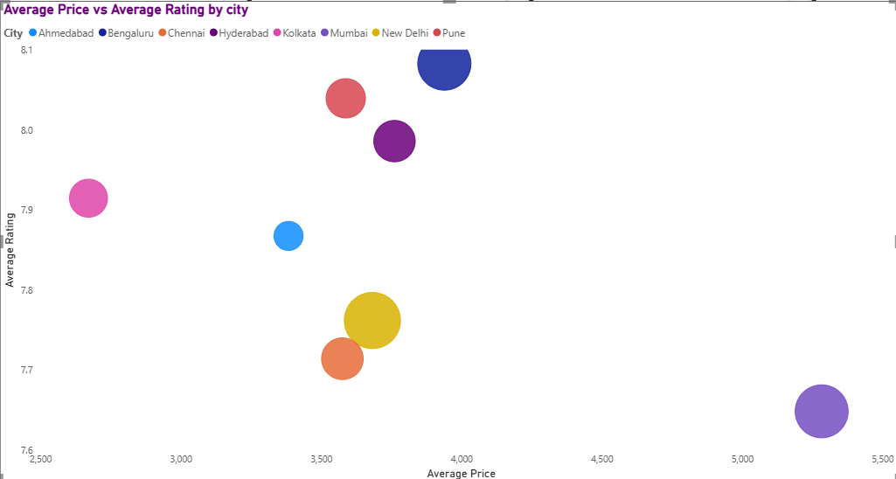
Price vs. Rating Correlation

Slide 13
Recommendation: Bridge the Digital Gap
• Goal: Transition 'No Rating' hotels to 'Rated' status.
• Action: Prioritize guest engagement campaigns on booking platforms.
• Result: Historically increases booking confidence and allows for higher pricing.

Slide 14
Recommendation: Service Quality Audits
• Target: Mumbai and Chennai (Lowest Ratings).
• Focus: High-demand regions where slight quality improvements justify luxury pricing.
• Strategy: Differentiate via niche offerings in saturated Tier 1 markets.

Slide 15
Final Insights
• Data-driven roadmaps are required to compete in India's diverse market.
• The 'Sweet Spot' lies in Mid-range hotels maintaining an 8+ rating.
• Future Growth: Tier 1 cities remain the backbone of hospitality inventory.

